Slide 1
State of Charge Estimator with Battery Swapping Station Locator for an Autonomous Vehicle
Guided by
Mr. Vikas Nagpal
(Project Manager)
Dr. Vijaya Margaret
(Assistant Professor)
Submitted by
Kush Jain -1560715

Slide 2
Contents
Agenda
Existing System
Problem Statement
Proposed System
Requirement Specification
Design
Code snippets
Results & Snapshots
Conclusion
Future plan
References
Queries

Slide 3
Agenda
To understand the need for State of Charge (SoC) estimation in Autonomous Vehicles in order to successfully implement the future way of re-fueling an electric vehicle, i.e, through battery swapping technology.

Slide 4
Abstract
Poor utilization of the existing conventional sources such as petroleum, oil, etc has made the world to confront an energy emergency. In the midst of Battery Innovation and developing ecological concern, the Autonomous and Electric Vehicles are becoming a need more than a luxury.
The projects is based on solving two major issues faced by Autonomous Vehicles, one being optimum utilization of the Battery and second being longevity of the Battery pack. To solve these issues my project would firstly target an accurate measurement of the State of Charge as it would help prevent over and under charging as well as discharging of the Battery when it is being monitored with the help of a pre-existing monitoring system.
Secondly to cancel out the ill effects of fast charging on a battery and also solve the long distance travel issues faced by a majority of the consumers, the project would implement battery swapping technology as well. This would allow the user to change the battery at various Battery Swapping Station in less than two minutes quicker then filling fuel at a petrol station and would allow the batteries to be charged at the Battery Swapping Station at optimal rates.
At the end of the project, the State of Charge measurement has been done and displayed on the android app and the Battery Swapping Station locator has been coded and implemented within the app as well.

Slide 5
Existing System
As of now, this kind of a system is not something that is readily available in the market and requires the Autonomous Vehicles and Electric Vehicles to come into more prominence and make huge strides in the Automobile Industry.
This, although is being tested by Sun Mobility on various e-bikes and e-rickshaws.

Slide 6
Problem Statement
In building a hassle free Autonomous Vehicle, which would, not for a second make the consumer feel that anything has changed from a conventional vehicle, has it own limitations and this project tries to deal with two of the many limitations. The two problems are the SoC measurement and a Battery Swapping Station Locator, which when solved, would make the Autonomous Vehicle experience a hassle free experience for the user.

Slide 7
Proposed System
The system proposed in this project is to develop a SoC measurement unit as well as implement the Battery Swapping Technology to an autonomous vehicle. SoC measurement unit is developed using a current sensor and voltage sensor in association with Lookup table Algorithm and Coulombic Counting Algorithm in togetherness. This data is then analysed by the microcontroller and sent to the app which would based on logic indicate a Battery Swapping Station

Slide 8
Requirement Specification
Hardware requirements:
CC-CV Circuit
Sensors
Microcontroller
MIT App Inventor
Software requirements:
Arduino Environment
Mbed os
MIT blocks

Slide 9
Design
CC-CV Method
Algorithms
Microcontroller
ThingSpeak

Slide 10
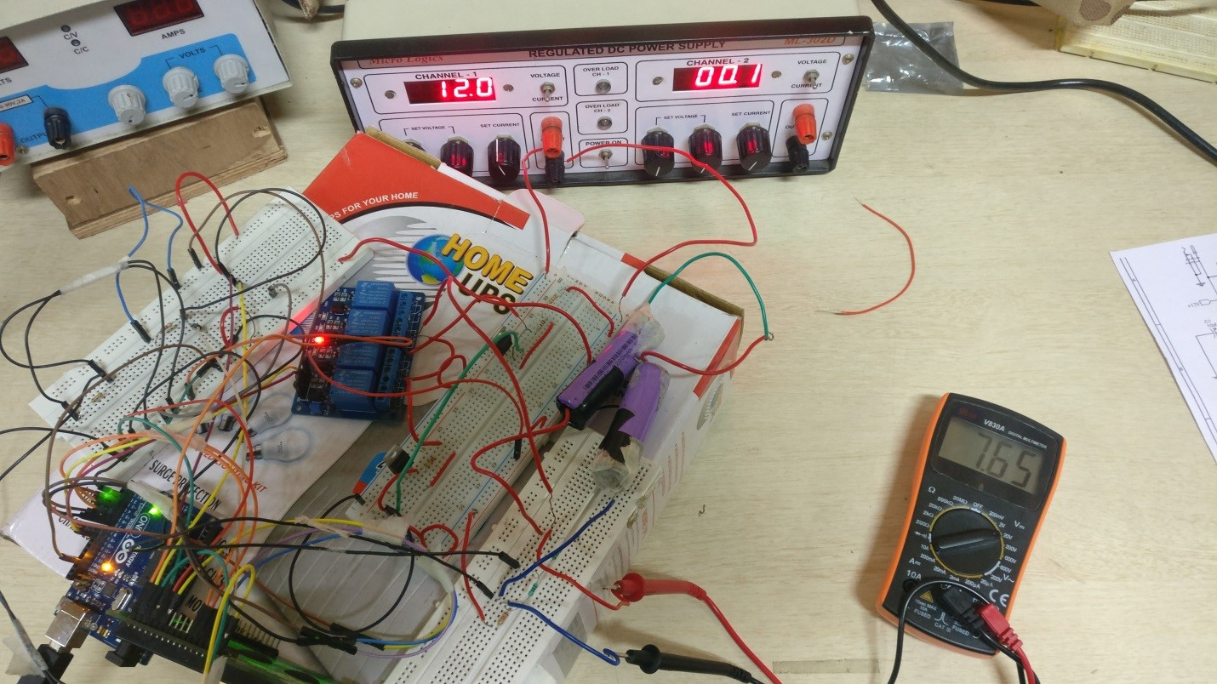
Implementation of CC-CV system

Slide 11
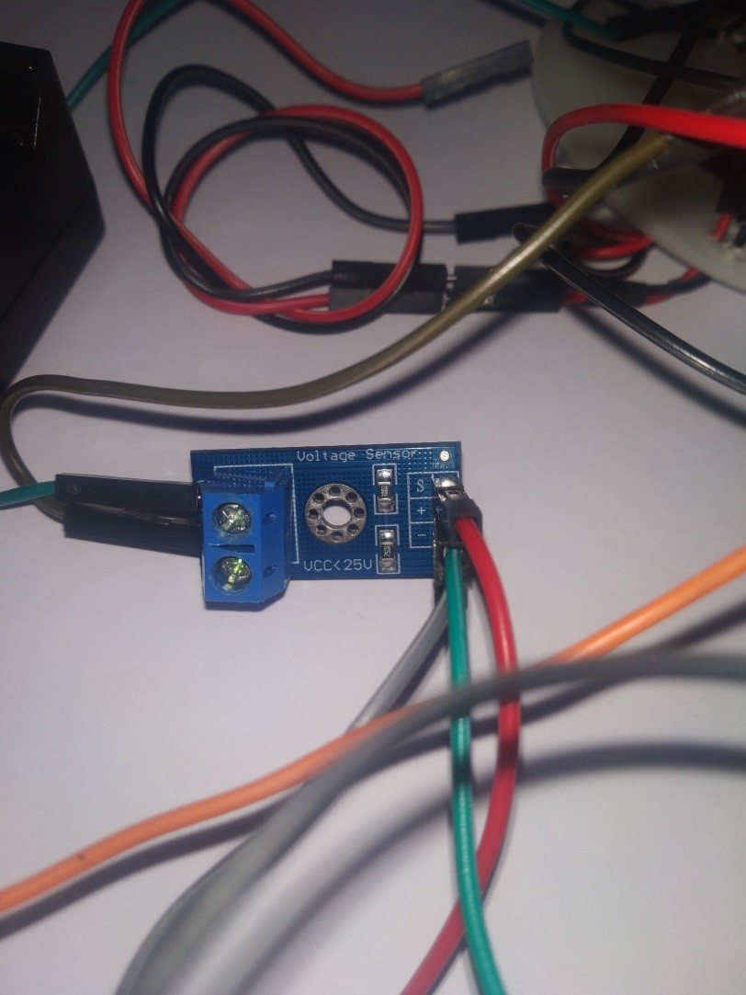
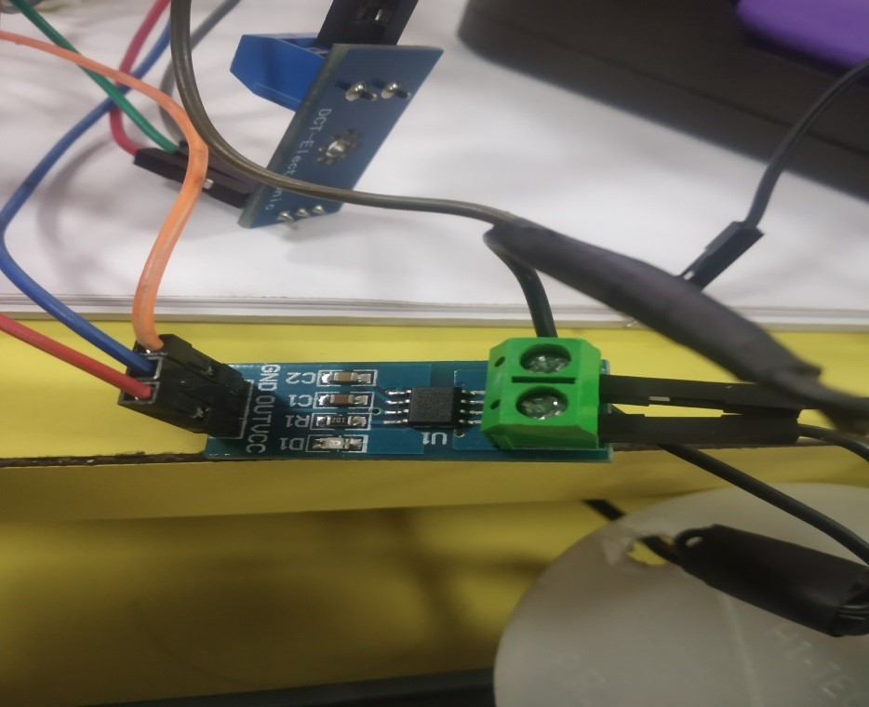
Implementation of Sensors

Slide 12
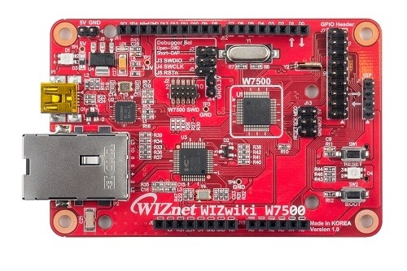
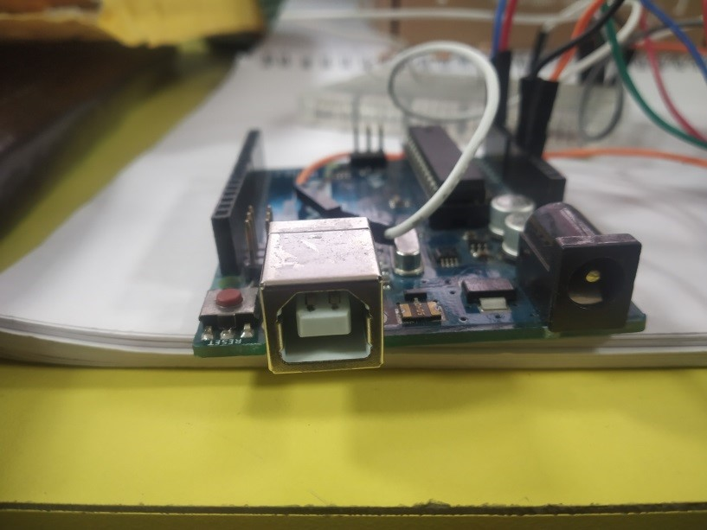
Implementation of Microcontroller

Slide 13
Modules implemented
CC-CV circuit
Database Creation
SoC Estimation
MIT App Inventor

Slide 14
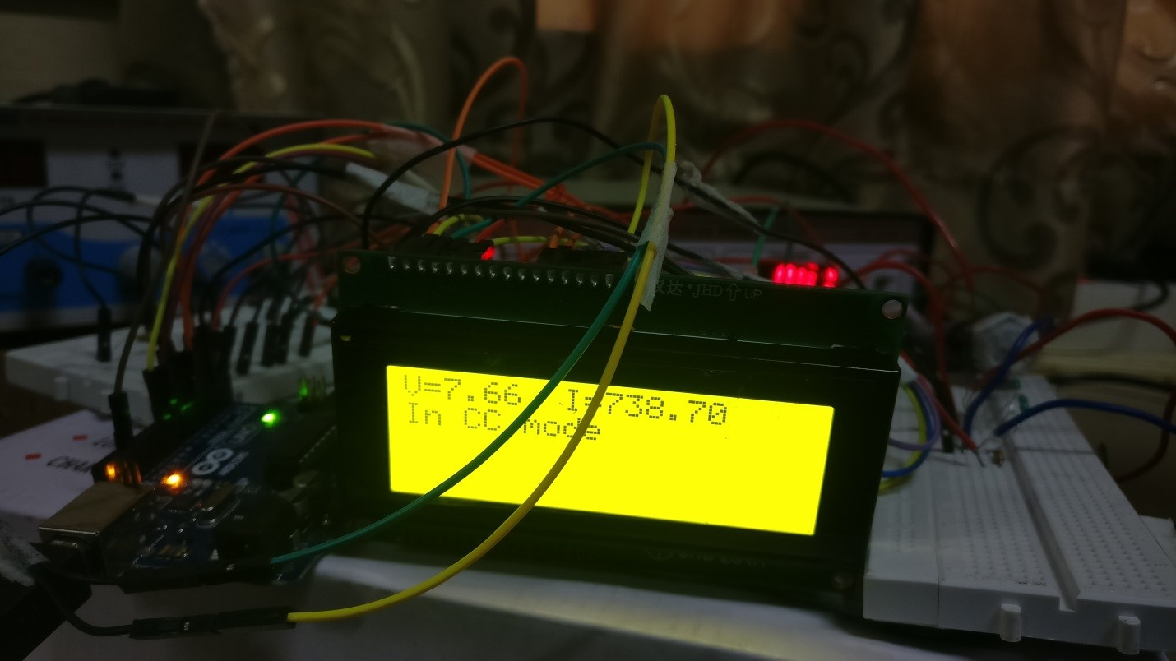
Results and snapshots
CC-CV circuit

Slide 15
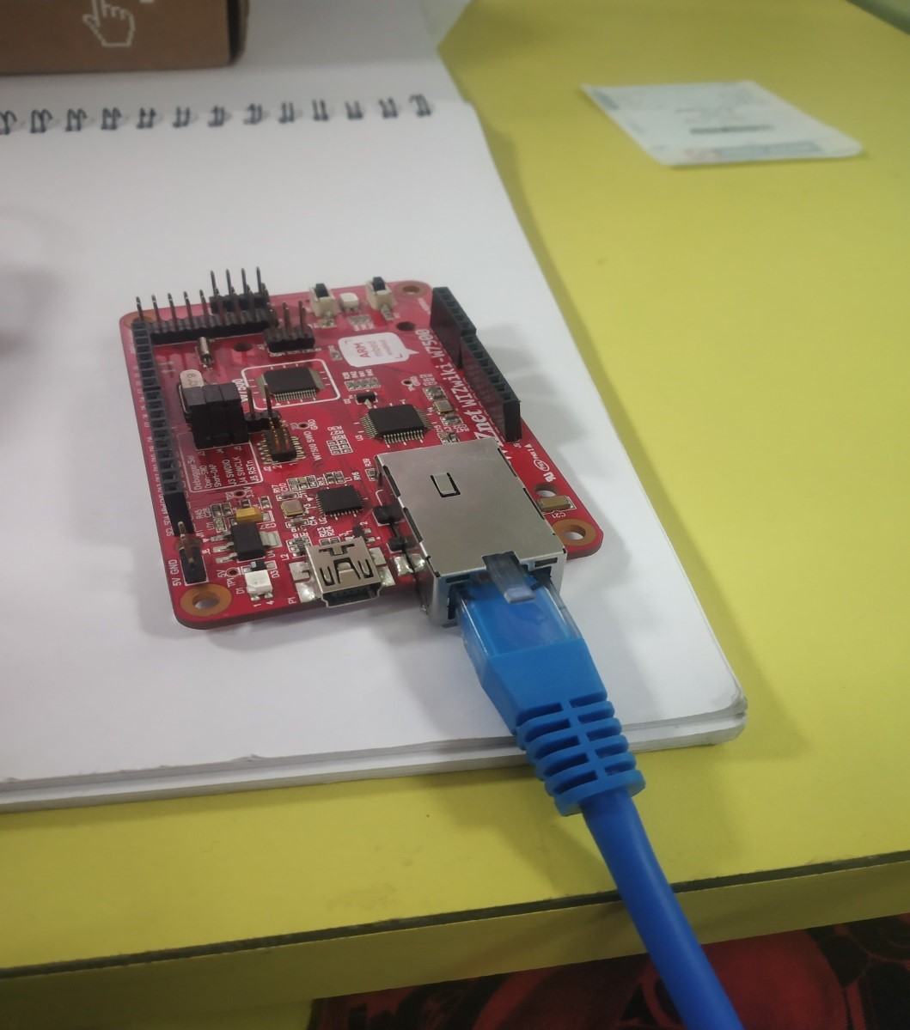
Database creation

Slide 16

Code Snippet for Database Creation

Slide 17
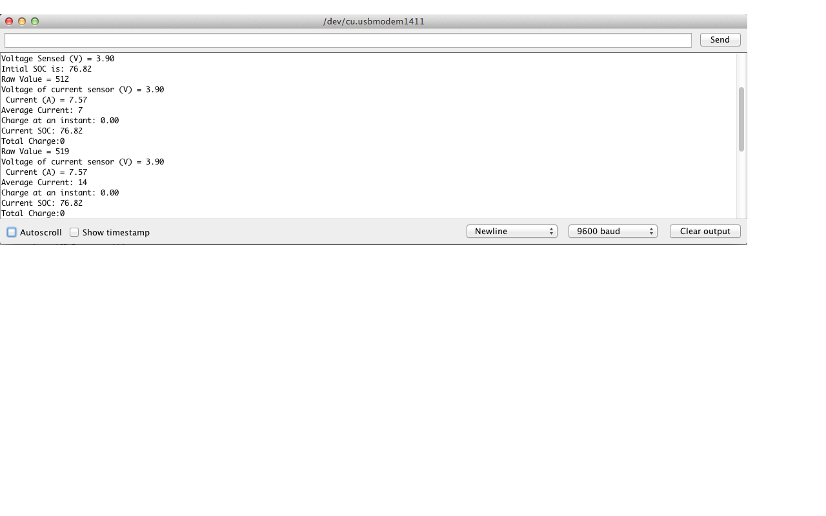
SoC estimation

Slide 18
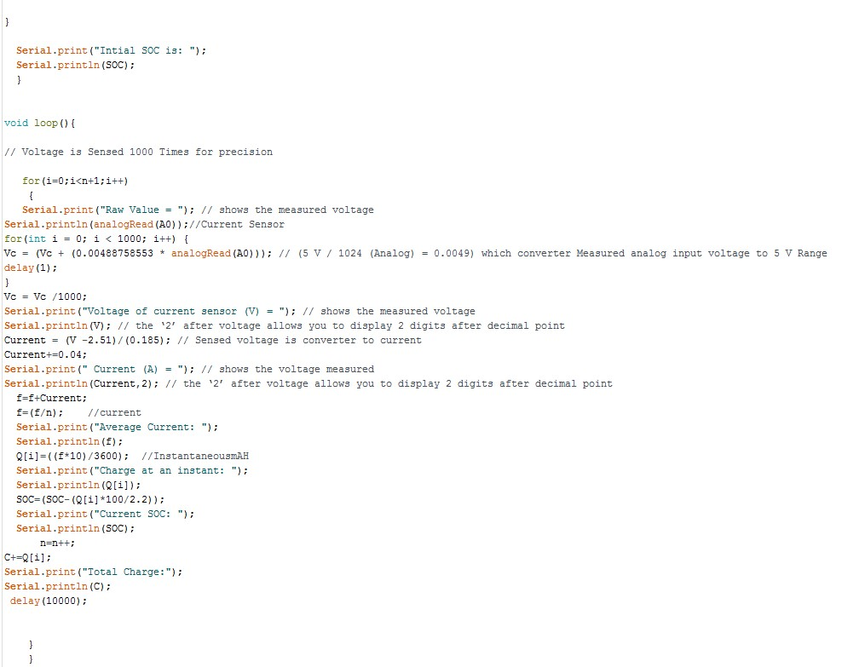
Code Snippet for SoC estimation

Slide 19
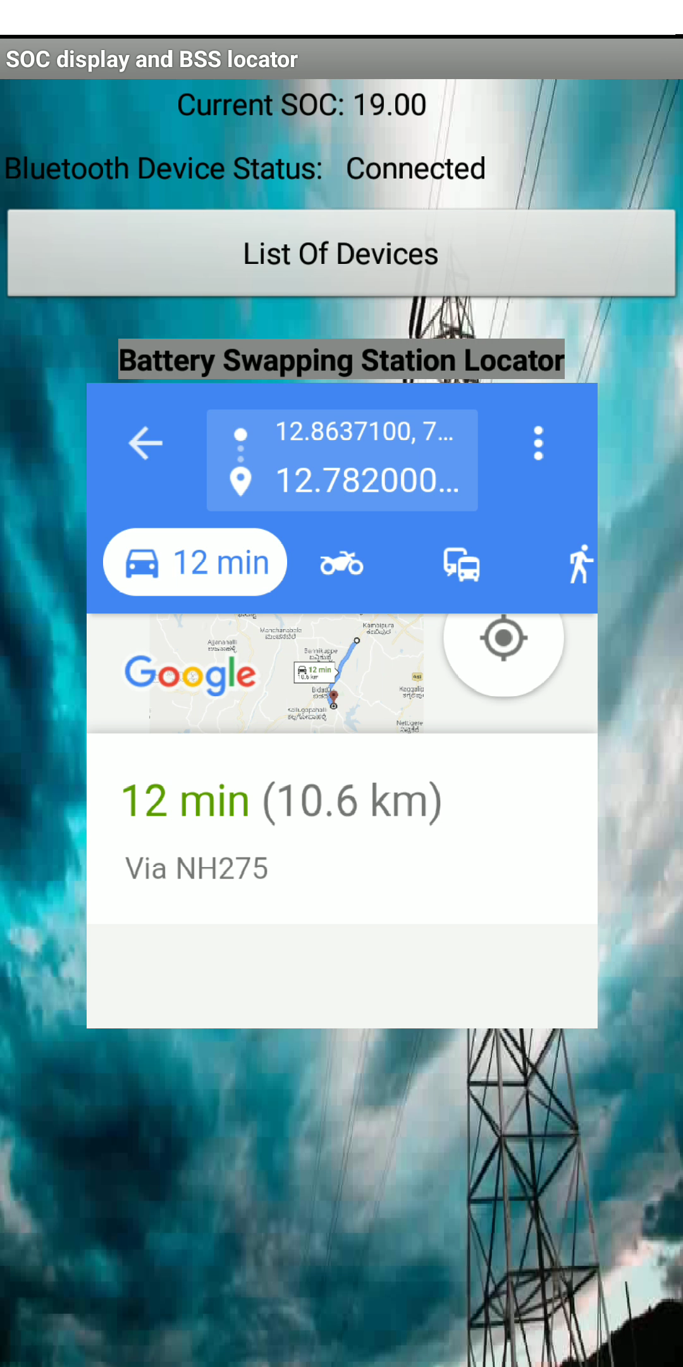
MIT App Inventor

Slide 20

Demonstration video

Slide 21
Conclusion
The major goal is to make the user feel that nothing has changed from a petrol/diesel car and the shift from conventional source to non-conventional source is smooth.
This project’s main aim was to get the SoC as accurately as possible using the two algorithms in combination (Look Up & Coulombic Counting Algorithm). Simulation, Hardware Implementation and analysis were performed and successfully tested on a 4.2V Lithium ion cell. Battery Swapping Station locator was also successfully created and tested.

Slide 22
Further Plans
By using ANN (Artificial Neural Network) Algorithms to make more adaptable in varied conditions. This project focusses only on SoC measurement of Li-Ion cell but using training data from various cells and feeding this data to the neural network, a common SoC code can be developed which would eliminate the complex issues of measuring SoC of various cells using different algorithms.
Battery Swapping Station locator can be improved by using Wi-Fi enabled chip so that the BSS database can be updated at regular intervals and also incase of improvement in the code, the firmware can also be updated for any further improvements that are to be implemented.

Slide 23
References
R. Yamin and A. Rachid, “Embedded state of charge and state of health estimator based on Kalman filter for electric scooter battery management system,” IEEE Fourth International Conference on Consumer Electronics Berlin (ICCE-Berlin), Berlin, pp. 440-444, August, 2014
Z. Yu, R. Huai, and L. Xiao, “State-of-Charge Estimation for Lithium-Ion Batteries Using a Kalman Filter Based on Local Linearization,” Energies, vol. 8, no. 8, pp. 7854–7873, July, 2015.
Wen-Yeau Chang, “The State of Charge Estimating Methods for Battery: A Review,” ISRN Applied Mathematics, vol. 2013, Article ID 953792, no. 7, November, 2013.

Slide 24
References
J.A.K.S. Jayasinghe and K.K.K.D. Nadishan, “Neural Network Based State of Charge (SOC) Estimation of Electric Vehicle Batteries,” International Journal of Scientific and Research Publications (IJSRP), Moratuwa, Sri Lanka, vol. 4, Issue 12, pp. 67-72, December, 2014.
Baccouche,SabeurJemmali,AsmaMlayah,BilalManai,andNajouaEssoukri Ben Amara, “Implementation of an improved Coulomb-Counting Algorithm Based on a Piecewise SOC-OCV Relationship for SOC Estimation of Li-Ion Battery,” Renewable Energy Research IJRER, Tunisia, North Africa, vol.8, no.1, March, 2018.
J. Poonsuk and S. Pongyupinpanich, “Design and Estimation of State-charging applied for Lithium-ion battery based on Matlab-Simulink,” 2016 Management and Innovation Technology International Conference (MITicon), Bang-San, pp. MIT- 176-MIT-179, May, 2016.

Slide 25
Queries

Slide 26
Thank you

